Slide 1


EMPLOYEE MANAGEMNET ANALYSIS
Presented By:
Manne Akshitha
Batch no: 456

Slide 2
Agenda
INTRODUCTION
BUSINESS PROBLEM
OBJECTIVE
ER DIAGRAM AND RELATIONSHIP
EMPLOYEE INSIGHTS
QUALIFICATION AND SKILLS ANALYSIS
JOB ROLE AND DEPARTMENT ANALYSIS
LEAVE AND ABSENCE PATTERNS
PAYROLL AND COMPENSATION ANALYSIS

Slide 3
INTRODUCTION
The Employee Management System (EMS) is a relational database solution designed to manage and organize employee-related data within an organization. The system centralizes employee information, job roles, departmental structures, payroll details, qualifications, and leave records into a structured and integrated database environment.
By implementing normalized tables with proper primary and foreign key relationships, the system ensures data integrity, consistency, and efficient data retrieval. The EMS enables management teams to perform analytical queries, monitor workforce performance, and leave management processes effectively.

Slide 4
BUSINESS PROBLEM
Identifying departments with the highest number of employees
Determining salary distribution and total payroll expenditure
Understanding leave patterns and their impact on payroll
Analyzing which job roles offer the highest compensation
Data Strategy:
I used SQL queries and JOIN operations to integrate multiple tables and extract meaningful insights
Transform raw employee data into actionable business intelligence.

Slide 5
OBJECTIVE
The objective of this project is to use SQL to analyze the provided employee dataset and generate actionable business insights.
Specifically, the project aims to:
Calculate total salary expenditure across the company
Identify highest-paid employees and job roles
Analyze department-wise employee distribution and payroll allocation
Examine leave patterns and their correlation with payroll amounts
Evaluate qualification distribution and skill requirements

Slide 6
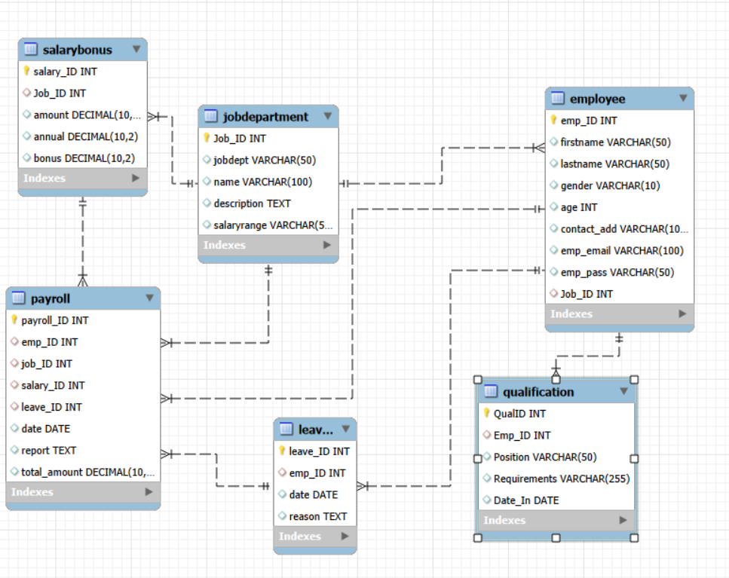
ER DIAGRAM

Slide 7
RELATION BETWEEN TABLES
• One-to-Many from JobDepartment to Employee
• One-to-Many from Employee to Leaves
• One-to-Many from Employee to Qualification
• One-to-Many from Employee to Payroll
• One-to-Many from SalaryBonus to Payroll
• One-to-Many from Leaves to Payroll

Slide 8
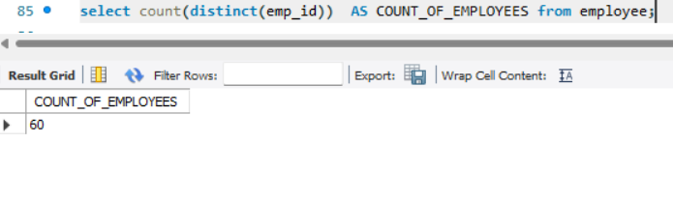
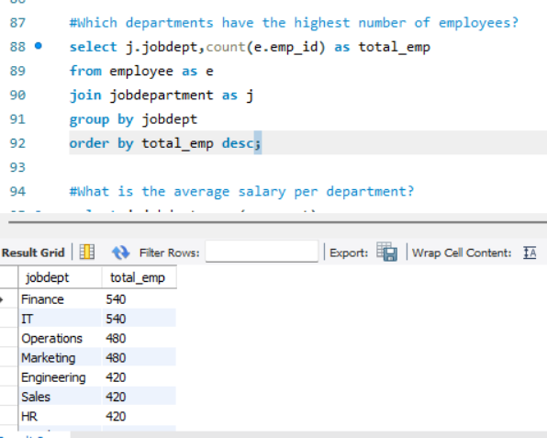
EMPLOYEE INSIGHTS
How many unique employees
are currently in the system?
Which departments have the
highest number of employees?

Slide 9
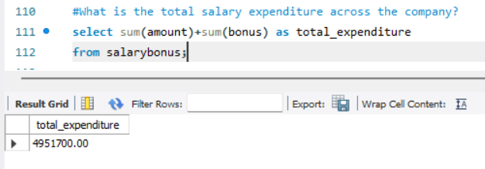
What is the total salary expenditure across the company?

Slide 10
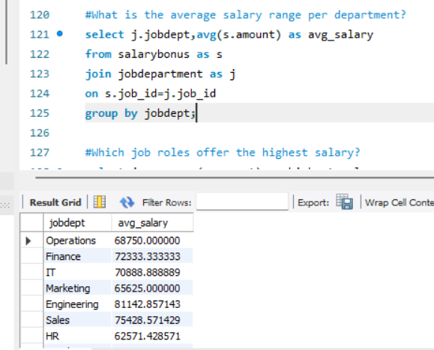
JOB ROLE AND DEPARTMENT ANALYSIS
What is the average salary per department?

Slide 11
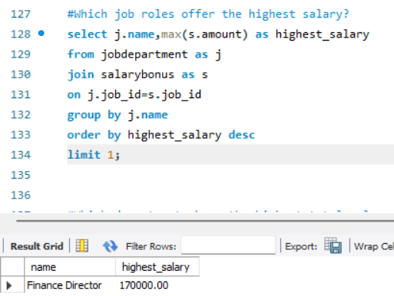
Which job roles offer the highest salary?

Slide 12
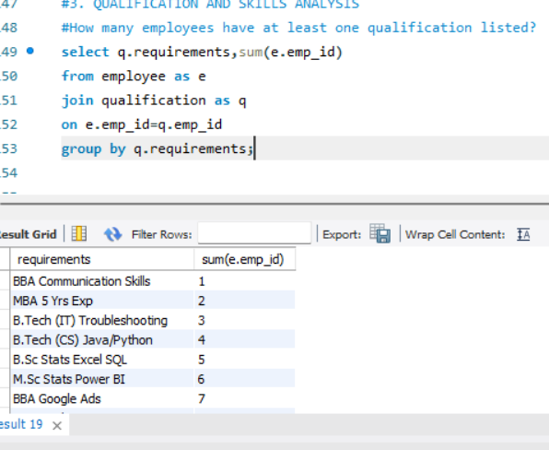
QUALIFICATION AND SKILLS ANALYSIS
How many employees have at least one qualification listed?

Slide 13
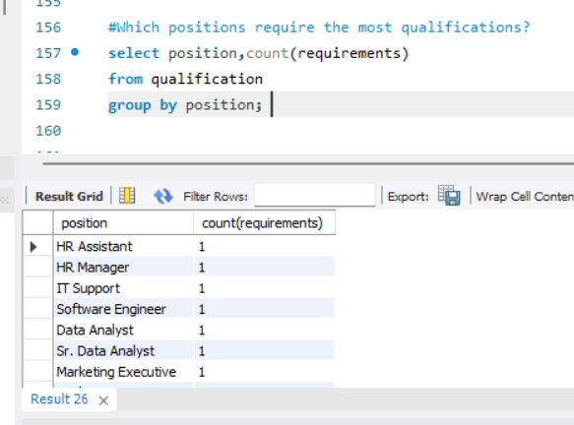
Which positions require the most qualifications?

Slide 14
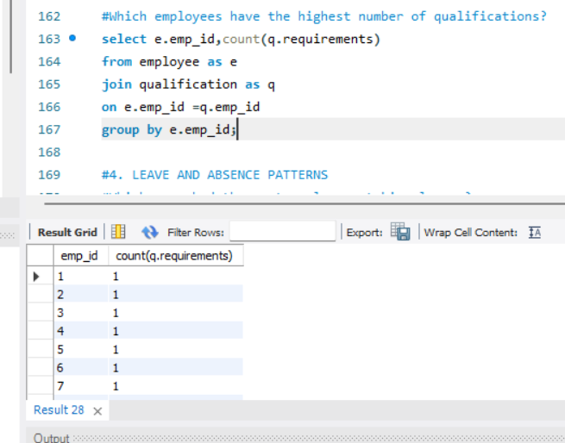
Which employees have the highest number of qualifications?

Slide 15
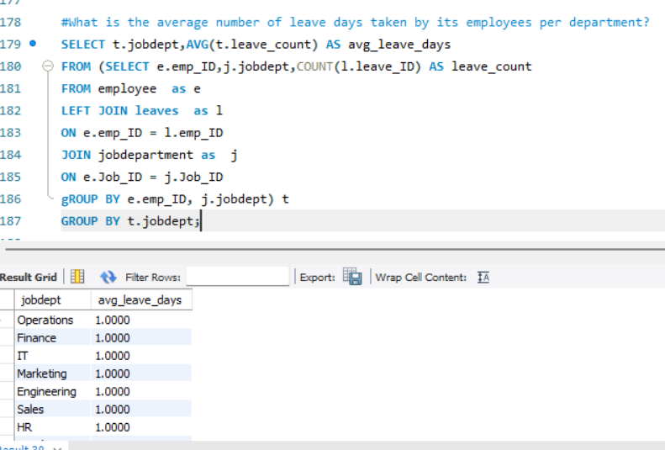
LEAVE AND ABSENCE PATTERNS
What is the average number of leave days taken by its employees per department?

Slide 16
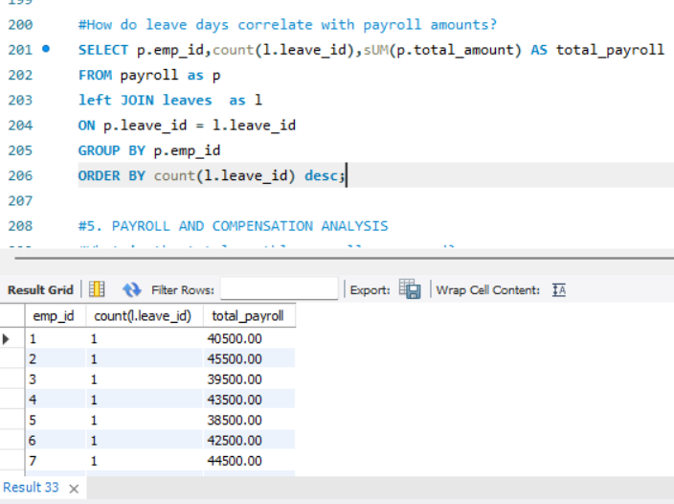
How do leave days correlate with payroll amounts?

Slide 17
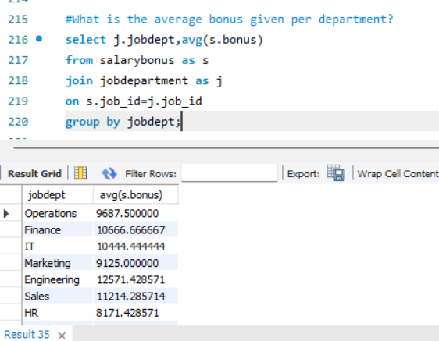
PAYROLL AND COMPENSATION ANALYSIS
What is the average bonus given per department?

Slide 18
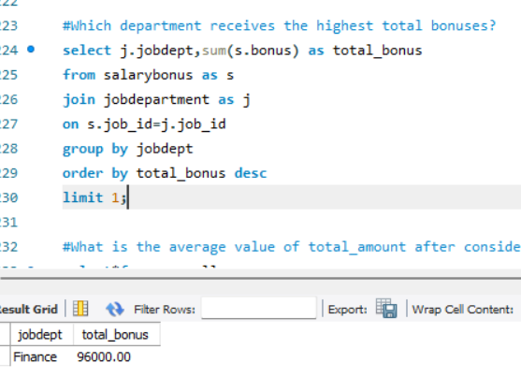
Which department receives the highest total bonuses?

Slide 19
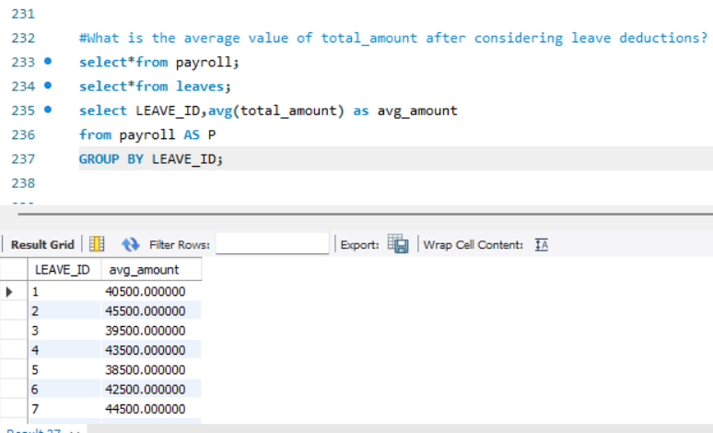
What is the average value of total amount after considering leave deductions?

Slide 20
FINAL INSIGHTS
The relational database design ensured structured storage of employee, payroll, leave, and department data with strong referential integrity.
Department-wise analysis revealed variations in employee distribution and salary allocation across different job roles.
Payroll analysis highlighted total company salary expenditure and identified highest-paid roles and employees.
Leave pattern analysis showed how employee absences can impact payroll calculations and overall compensation trends.
Qualification tracking provided insights into skill distribution and helped identify roles requiring higher expertise.
Identified highest and average bonus

Slide 21
RECOMMENDATION
Use a centralized SQL database for structured data management.
Apply SQL queries and JOINs to generate meaningful insights.
Monitor payroll and leave trends for better cost control.
Automate employee reports for faster decision-making.
Ensure data integrity through proper database design.

Slide 22
CONCLUSION
The Employee Management System project successfully demonstrates to design and manage a structured relational database for handling employee, payroll, leave, and department data. By applying joins, constraints, and analytical queries, the project provides meaningful insights and supports efficient workforce and payroll management.

Slide 23
Q &A

Slide 24

THANK YOU

